Slide 1


Slide 2
Discussion outline
Participation Guidelines
  Combination discussion & podcast
    Recorded and Press will post excerpts
  Hold questions or comments until the end
  Put clarifying questions in Chat immediately
    And our meeting facilitator will address them as flow permits
Michael Gates – the Huntington Beach Housing Experience
Los Angeles & South Bay Council concerns
Marin County & Wake Up Calif.
How does it affect YOU?
What we can do about it…

Slide 3
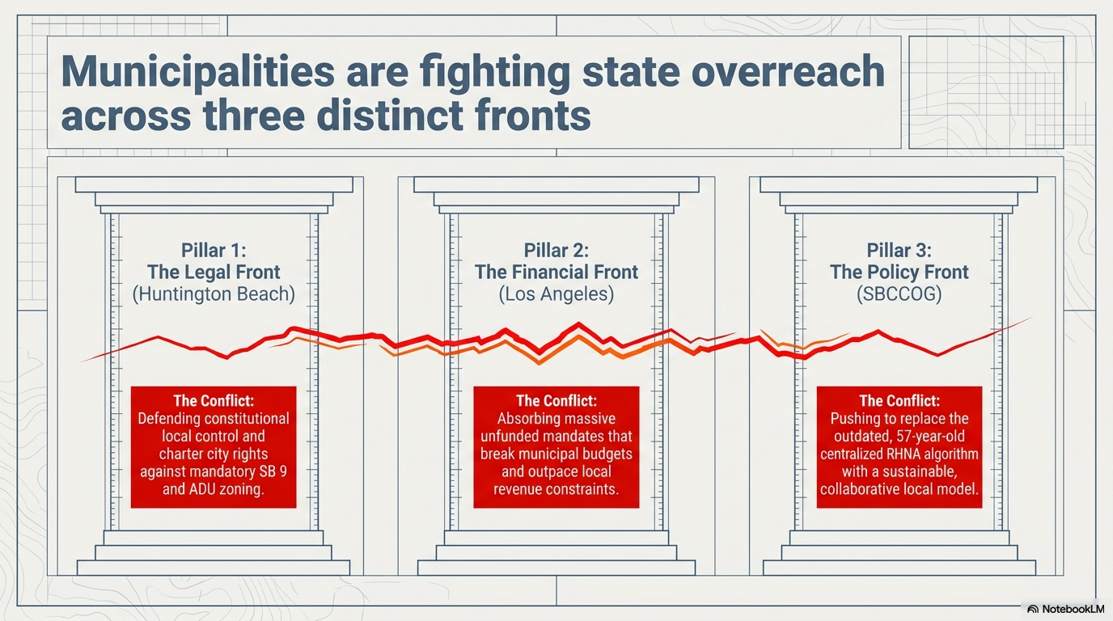

Slide 4
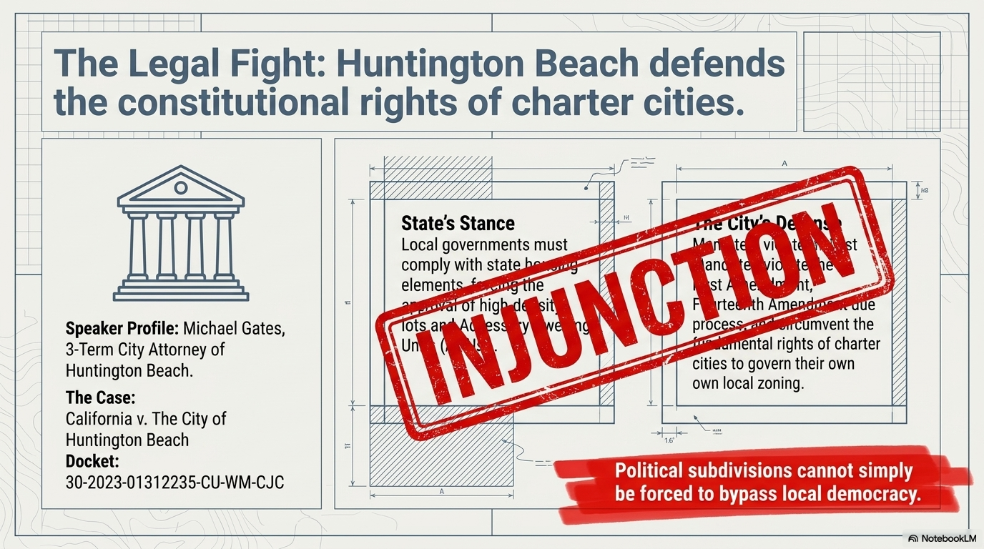

Slide 5
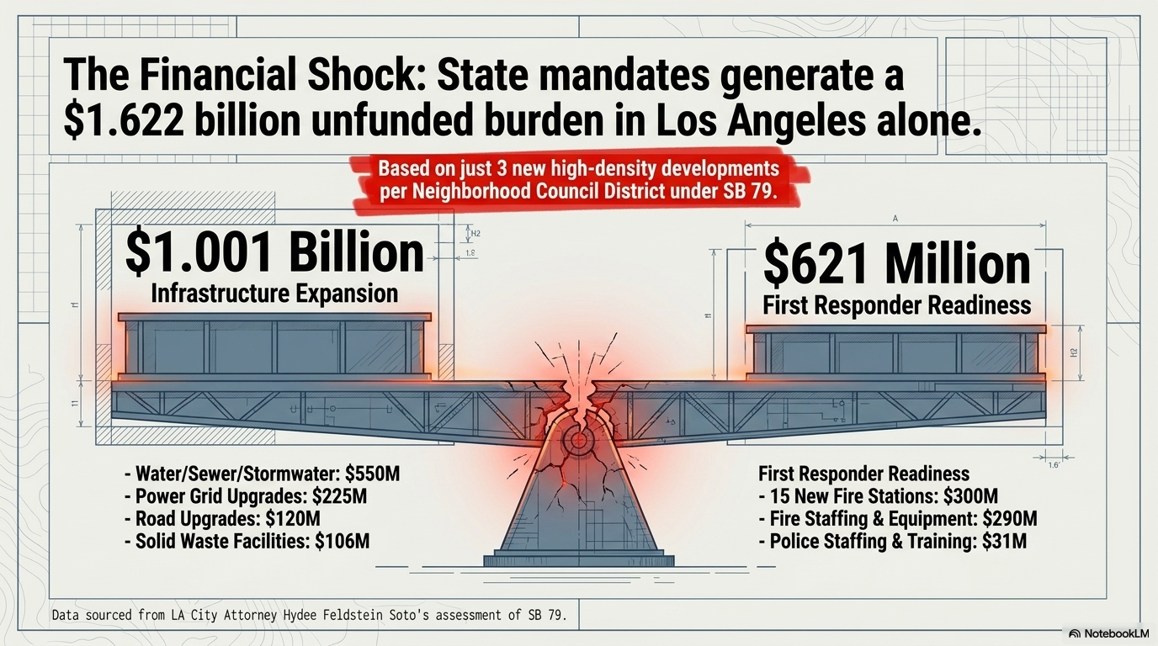

Slide 6
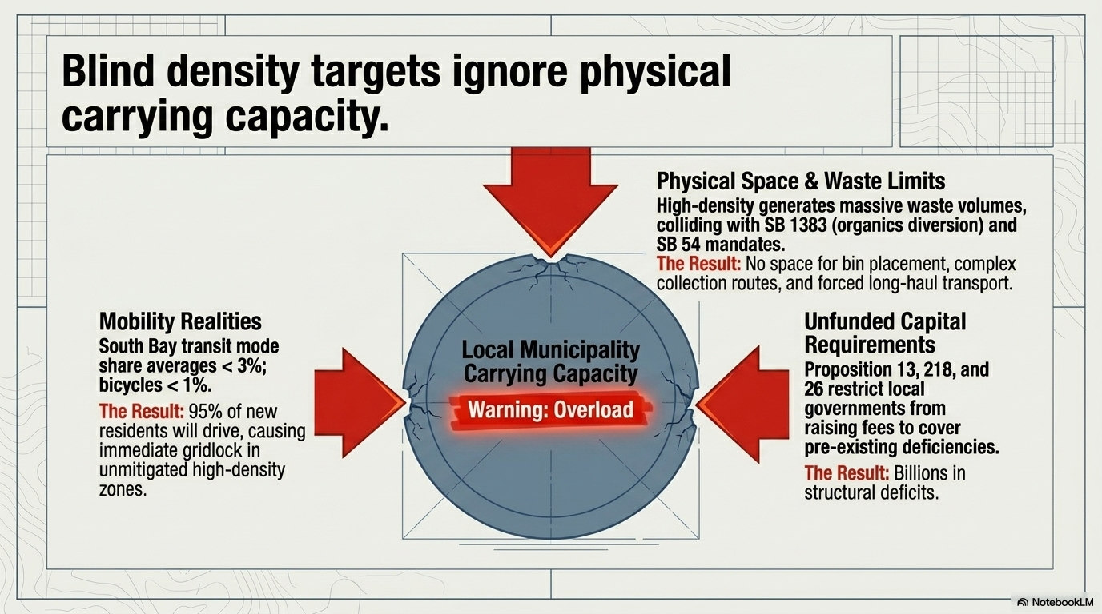

Slide 7
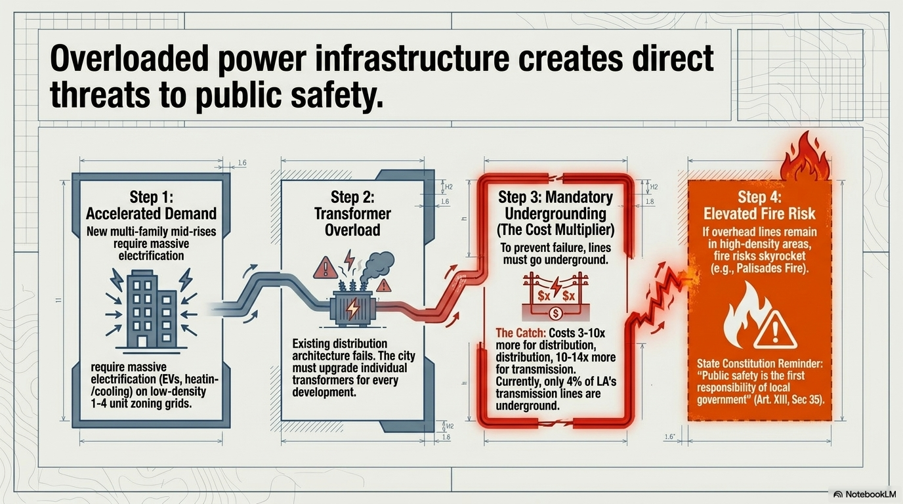

Slide 8
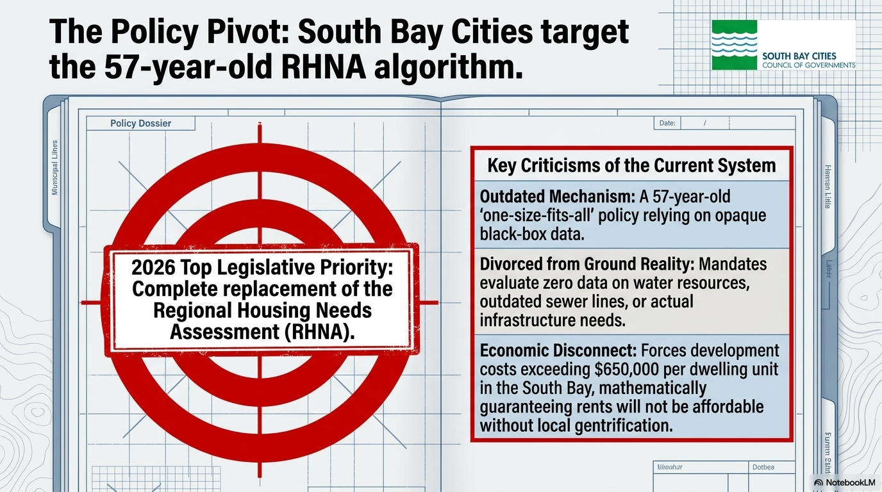

Slide 9
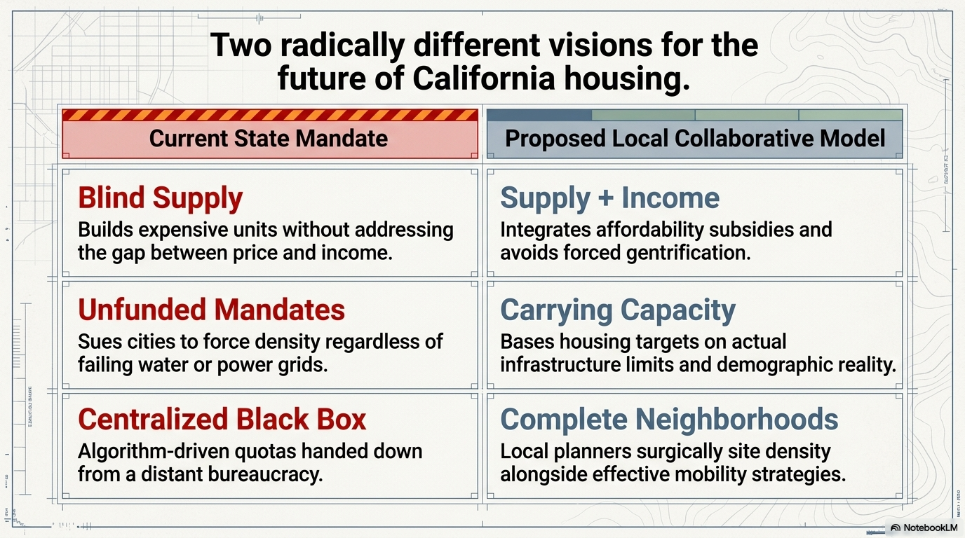

Slide 10
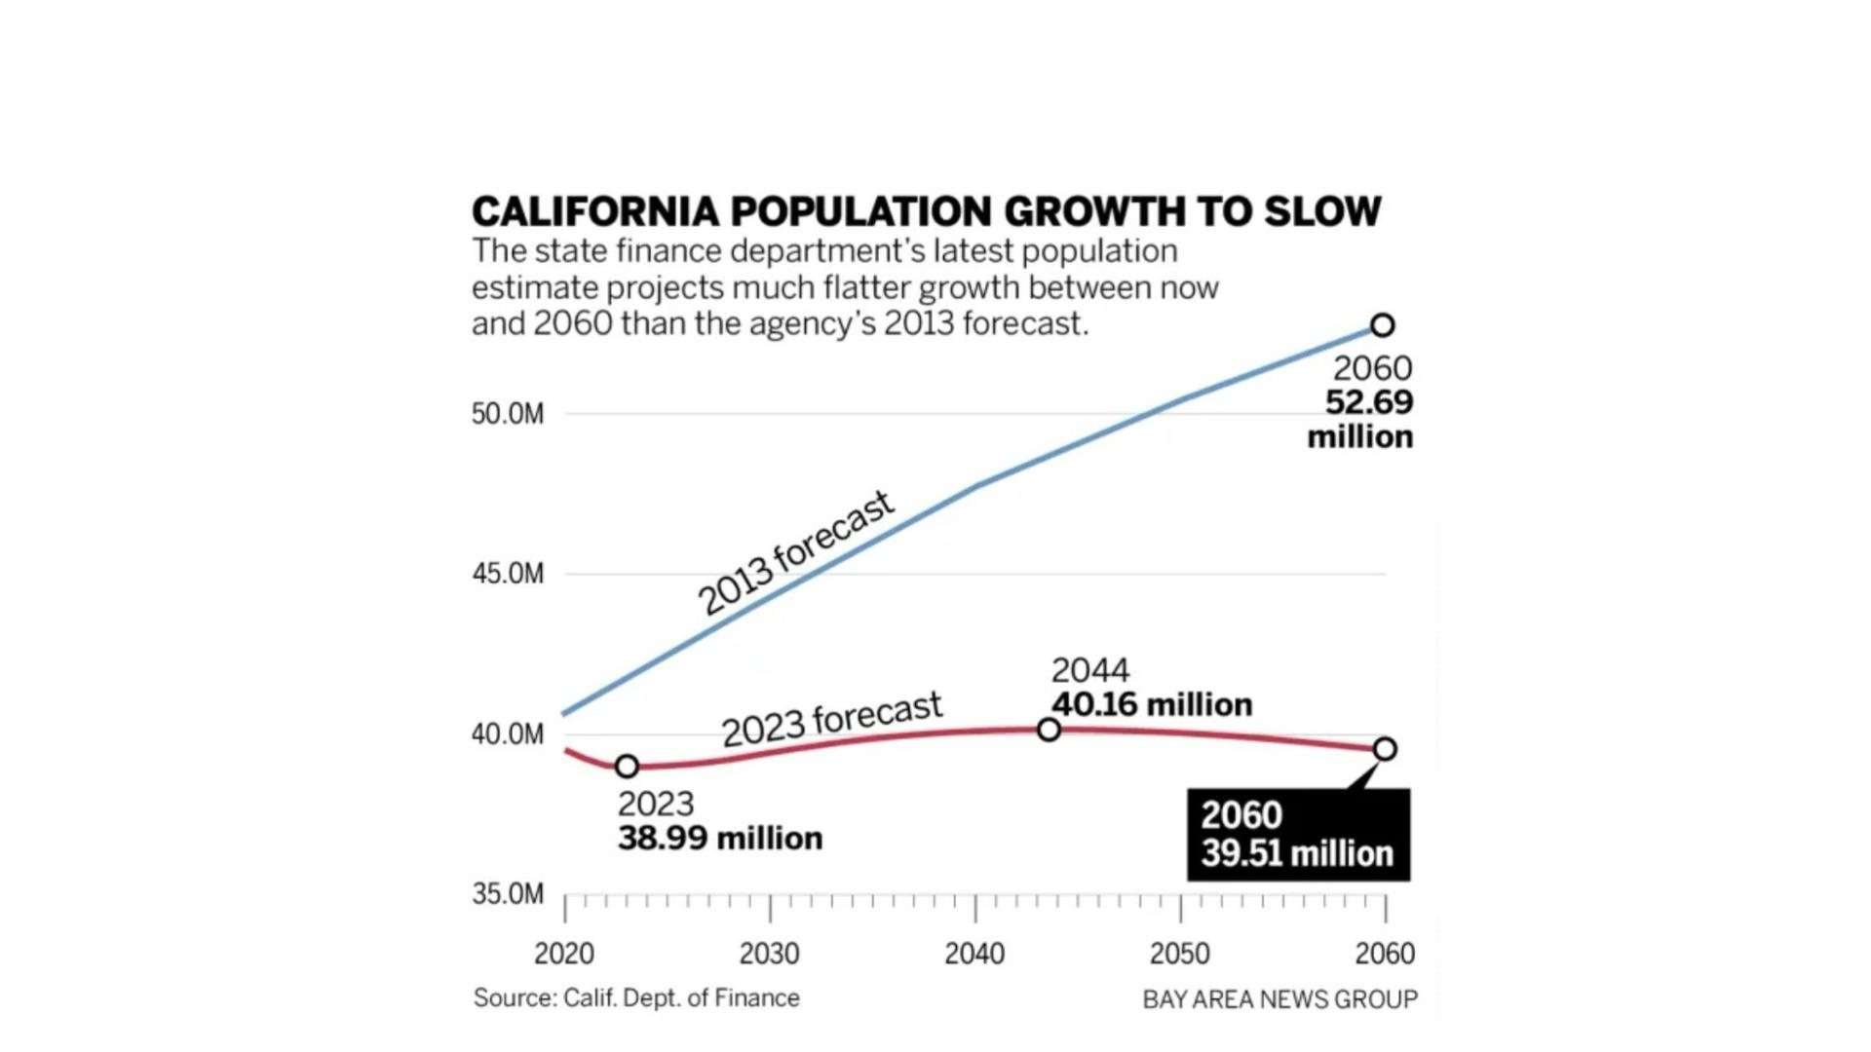
V I S U A L E V I D E N C E
Published and Forgotten
13 / 17

Slide 11

T H E
I N F L E C T I O N
P O I N T
The 6th Cycle Changed Everything
W H A T C H A N G E D
~2.5 million units
E X A M P L E
T O T A L R H N A
·
M A R I N C O U N T Y
Statewide target jumped to a historically unprecedented number
2,298 → 14,405
Became enforceable
RHNA carried legal consequences for the first time
U N I N C O R P O R A T E D M A R I N
185 → 3,569
New compliance burden
Reporting and tracking requirements added
Nearly 20× increase
Many cities saw housing targets increase 10× to 20× in a single
cycle.
Cities were required to plan for these increases regardless of
local constraints.
W A K E
U P
C A L I F O R N I A
6 / 17

Slide 12
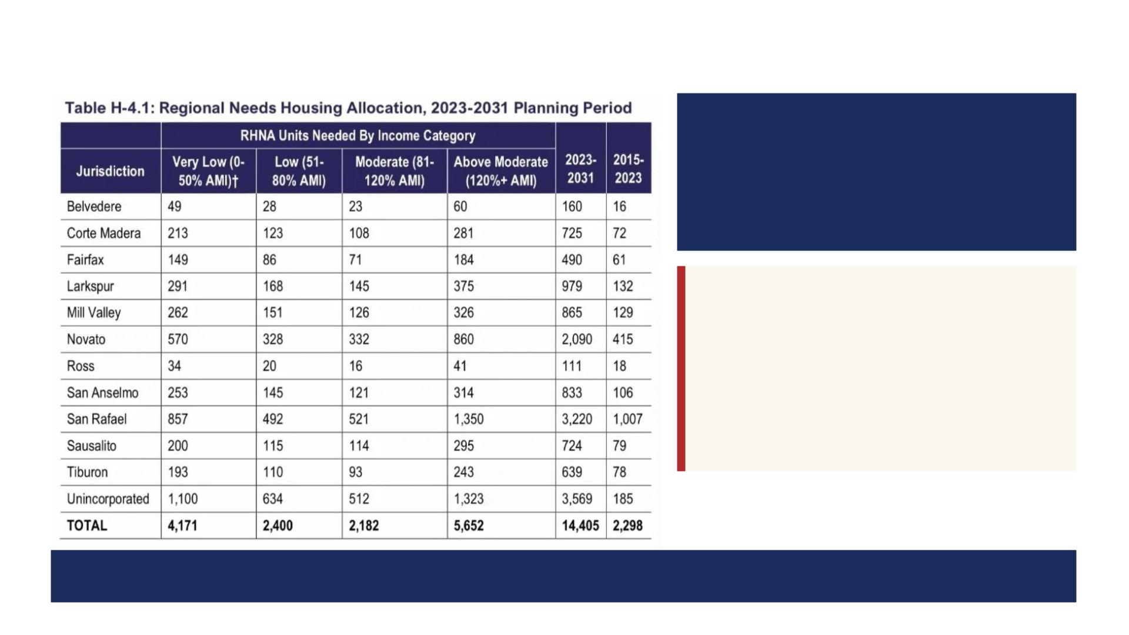
R H N A A L L O C A T I O N
B Y
I N C O M E C A T E G O R Y
6th Cycle · Marin County
T O T A L
U N I T S
2,298 → 14,405
Over 6× increase
W H E R E
T H E
G R O W T H
W E N T
Above Moderate
5,652 of 14,405 units — the largest single category by far.
39%
Cities must plan for all income levels — but the majority of units are still in higher-income categories.
7 / 17

Slide 13

T H E
C O S T
Expensive. Time-Consuming.
Unfunded.
W H A T I T R E Q U I R E D
$10
● Unfunded m andate — no state money for housing
MILLION
element work
● New requirements forced cities to bring in outside
consultants
spent in Marin County a lone — on
consultants writing housing elements. No
tally of staff and in-house legal.
● In hazard areas, tough decisions were made
● Long HCD turnaround for review
● Most localities missed their deadlines
● Guidance from HCD was vague
None of it went to building actual housing.
W A K E
U P
C A L I F O R N I A
10 / 17

Slide 14

T O P - D O W N R I G I D I T Y
Appeals Were Allowed —
But Didn't Change Outcomes
W H A T H A P P E N E D
Cities appealed RHNA numbers
K E Y F I N D I N G
Based on “changed circumstances”
There was no adjustment to RHNA
Appeals cited real constraints
targets, even when conditions
materially changed.
Wildfire risk, evacuation limits, infrastructure gaps, environmental conditions
Reviewed by regional agencies (COGs)
Each appeal heard at the regional level
L O O K I N G F O R W A R D
All appeals denied
The next RHNA cycle will not
allow appeals.
No adjustment to assigned targets
W A K E
U P
C A L I F O R N I A
8 / 17

Slide 15

W H E R E T H I S L E A V E S U S
What This Means
Land use control was transferred
From communities, planning commissions, and local governments — to a for-profit industr y.
The mix is unbalanced
85% market-rate housing vs. 15% across all lower-income categories.
Cities are judged by developers' actions
HCD doesn't count approvals — only permits pulled, an action a developer takes when ready to build.
Cities face constant exposure
Lawsuits and "punishment" projects: Builder's Remedy, SB 35, SB 423.
Affordability isn't being touched
The crisis the system claims to address isn't actually being solved.
W A K E
U P
C A L I F O R N I A
14 / 17

Slide 16
So what, and now what?
What are your observations about State housing policy?
What actions do you recommend to foster change?
Meeting materials will be posted on SHIFT website
  Along with related research materials
Wake Up California focuses on Housing: www.wakeca.org
  And is acquiring related organizations into its network
SHIFT will continue to research and document impacts, and alternatives, e.g.
  The fiscal burden on local governments
  The cost/benefit of current and future Transit alternatives
  What real accountability should exist
  Our next seminar will feature a national expert in Urban Planning and Transit

Slide 17

P O L I C Y
P R I M E R
A Brief Overview:
RHNA and Housing Elements
And what to make of a 2.5 million un it mandate
W A K E U P
C A L I F O R N I A
Amy Kalish · May 4, 2026
© 2026 · Please do not duplicate without permission

Slide 18

W H E R E I T S T A R T E D
RHNA Housing Cycles
Regional Housing Needs Assessment
Pronounced "REE-nuh." The state's housing target system.
O R I G I N
P U R P O S E
E N F O R C E M E N T
1969
Plan
Guide
California has had RHNA since 1969
Designed to give cities an idea of what to
plan for
Had no enforcement mechanism — used as a
guideline
W A K E
U P
C A L I F O R N I A
2 / 17

Slide 19

H O W T H E N U M B E R I S B U I L T
Where Does RHNA Come From?
California Department of Housing and Community
Coalitions Of Governments
Development
Creates RHNA targets
Regional bodies (e.g., ABAG for the Bay Area)
H O W T H E N U M B E R F L O W S D O W N
HCD creates the number
Using census data + population and jobs projections from the CA Dept . of Finance
HCD splits by region
Distributes the s tat ewi de number to each Coalition of Governments (COG)
The COGs assign to localities
Each COG distributes its share to cities and counties in its jurisdiction
W A K E
U P
C A L I F O R N I A
3 / 17

Slide 20

1 9 8 2 — B E F O R E E N F O R C E M E N T
The Housing Accountability Act
Purpose
Enacted in 1982 to address the housing crisis by preventing local government obstruction /delays and curbing the arbitrary denial of housing projects.
Objective Standards Only
Local agencies cannot reject projects based on subjective criteria like "neighborhood ch arac ter." They must use written, obje ctive standards.
Approval Requirement
If a project complies with all objective General Plan and zoning standards, the government must approve it.
Limitation on Reductions
A project's density cannot be reduced below the allowed level unless necessary to comply with safety standards.
W A K E
U P
C A L I F O R N I A
4 / 17

Slide 21

T H E
S T R E A M L I N I N G L O G I C
What “ Qui ck Approvals” Co st
Fast-tracking approvals requires eliminating ”inhibitors to housing.” The state's path identifies three:
Local Input
OUR VOICES: Public hearings, community comment, planning commission discretion
Planning & Zoning
LOCAL CONTROL: General Plan revi ew, site-specific zoning standards, density limits
CEQA & Impact Studies
IMPACTS CAN’T BE USED FOR MITIGATION NEGOTIATION: environmental revi ew, fire risk, evacuation capacity, traffic and water analysis
W A K E
U P
C A L I F O R N I A
5 / 17

Slide 22
T H E
I N F L E C T I O N
P O I N T
The 6th Cycle Changed Everything
W H A T C H A N G E D
~2.5 million units
E X A M P L E
T O T A L R H N A
·
M A R I N C O U N T Y
Statewide target jumped to a historically unprecedented number
2,298 → 14,405
Became enforceable
RHNA carried legal consequences for the first time
U N I N C O R P O R A T E D M A R I N
185 → 3,569
New compliance burden
Reporting and tracking requirements added
Nearly 20× increase
Many cities saw housing targets increase 10× to 20× in a single
cycle.
Cities were required to plan for these increases regardless of
local constraints.
W A K E
U P
C A L I F O R N I A
6 / 17

Slide 23
R H N A A L L O C A T I O N
B Y
I N C O M E C A T E G O R Y
6th Cycle · Marin County
T O T A L
U N I T S
2,298 → 14,405
Over 6× increase
W H E R E
T H E
G R O W T H
W E N T
Above Moderate
5,652 of 14,405 units — the largest single category by far.
39%
Cities must plan for all income levels — but the majority of units are still in higher-income categories.
7 / 17

Slide 24
T O P - D O W N R I G I D I T Y
Appeals Were Allowed —
But Didn't Change Outcomes
W H A T H A P P E N E D
Cities appealed RHNA numbers
K E Y F I N D I N G
Based on “changed circumstances”
There was no adjustment to RHNA
Appeals cited real constraints
targets, even when conditions
materially changed.
Wildfire risk, evacuation limits, infrastructure gaps, environmental conditions
Reviewed by regional agencies (COGs)
Each appeal heard at the regional level
L O O K I N G F O R W A R D
All appeals denied
The next RHNA cycle will not
allow appeals.
No adjustment to assigned targets
W A K E
U P
C A L I F O R N I A
8 / 17

Slide 25

W H A T L O C A L I T I E S H A D T O P R O D U C E
The Housing Element
1
Site the Units
2
Safety Element
3
Environmental Impact
Report
In fo ur income categories — with a buffer
above the RHNA number. Very specific
category targets must be sited
Address fire, flood, evacuation, and other
hazards — but not use the report to inhibit
housung
Full EIR for the housing element, but not use
specific and unavoidable impacts to limit
housing.
4
Demographics &
5
AFFH Plan
6
Upzone & Update
Statistics
General Plan
Detailed documentation of population and
need, with required language describing the
housing crisis as a crisis at all levels.
Affirmatively Furthering Fa ir Housing — a
federally rooted plan now used to densify
“opportunity zones” with very low and low
income units, regardless of economic factors.
Rezone and upzone, even in hazards and
environmentally sensitive areas; update the
General Plan to match. Careful upzoning later
subject to density bonus law.
W A K E
U P
C A L I F O R N I A
9 / 17

Slide 26
T H E
C O S T
Expensive. Time-Consuming.
Unfunded.
W H A T I T R E Q U I R E D
$10
● Unfunded m andate — no state money for housing
MILLION
element work
● New requirements forced cities to bring in outside
consultants
spent in Marin County a lone — on
consultants writing housing elements. No
tally of staff and in-house legal.
● In hazard areas, tough decisions were made
● Long HCD turnaround for review
● Most localities missed their deadlines
● Guidance from HCD was vague
None of it went to building actual housing.
W A K E
U P
C A L I F O R N I A
10 / 17

Slide 27

T H E
S T A T E
A U D I T O R
F O U N D
The 2.5M Number Failed an Audit
B E F O R E T H E P A N D E M I C
The 2.5M-unit requirement was already not in line with projected population growth.
T H E A U D I T F O U N D
Numbers were not reliable or reproducible. The methodology was opaque. "HCD risked losing
public confidence…"
T H E R E S P O N S E
The audit was ignored. The 2.5M wasn't adjusted. The Bay Area got 441,000 units.
W A K E
U P
C A L I F O R N I A
11 / 17

Slide 28
V I S U A L E V I D E N C E
Published and Forgotten
13 / 17

Slide 29

D E S P I T E
T H E E V I D E N C E
RHNA Is Unsubstantiated
A F T E R T H E A U D I T
HCD didn't change the numbers.
The State Auditor's findings — that the methodology was opaque and unreliable — we nt unanswered.
A F T E R T H E D O F P R O J E C T I O N S D R O P P E D
HCD didn't change the numbers.
Even after the Department of Finance dramatically lowered its long-term population forecast, the 2.5M unit
mandate remained untouched.
W A K E
U P
C A L I F O R N I A
12 / 17

Slide 30
W H E R E T H I S L E A V E S U S
What This Means
Land use control was transferred
From communities, planning commissions, and local governments — to a for-profit industr y.
The mix is unbalanced
85% market-rate housing vs. 15% across all lower-income categories.
Cities are judged by developers' actions
HCD doesn't count approvals — only permits pulled, an action a developer takes when ready to build.
Cities face constant exposure
Lawsuits and "punishment" projects: Builder's Remedy, SB 35, SB 423.
Affordability isn't being touched
The crisis the system claims to address isn't actually being solved.
W A K E
U P
C A L I F O R N I A
14 / 17

Slide 31
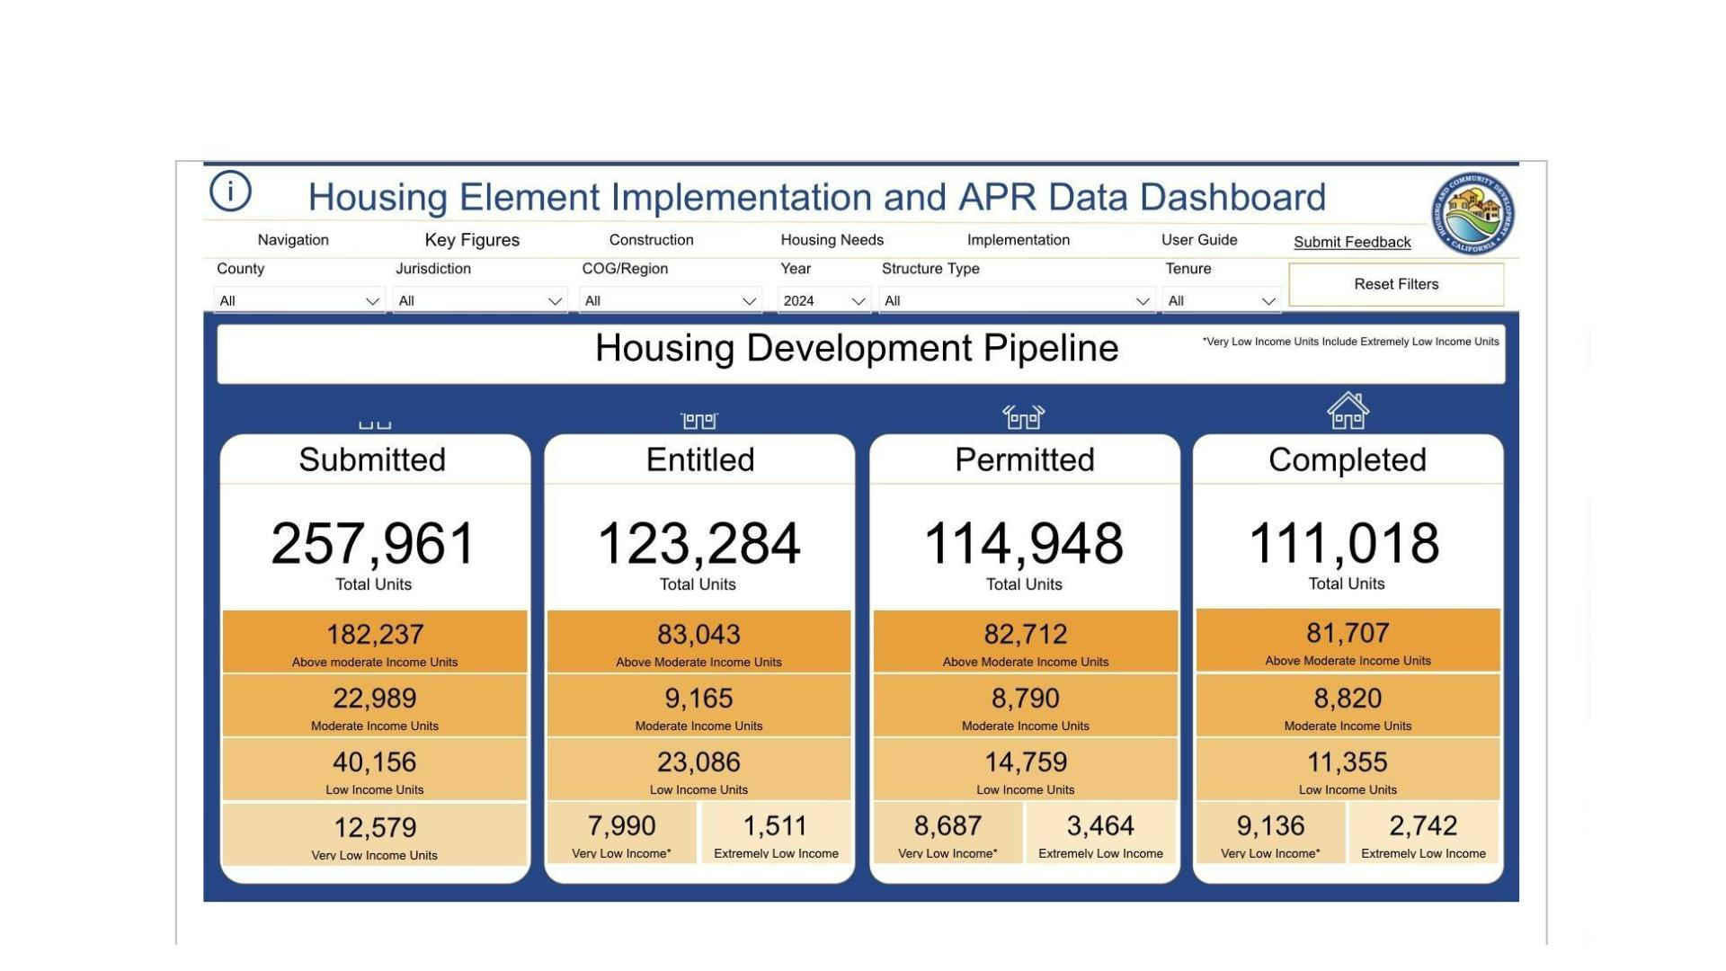
H C D A C C O U N T A B I L I T Y D A S H B O A R D ,
P A G E 3
Housing Development Pipeline
15 / 17

Slide 32

T H E Q U E S T I O N F O R E V E R Y P O L I C Y M A K E R
“If the state's own auditor said the numbers aren't reliable—
and the state's own DOF said the estimates were way off…
why are cities still being
punished for missing them?”
W A K E
U P
C A L I F O R N I A
16 / 17

Slide 33

L E A R N M O R E
·
G E T I N V O L V E D
Wake Up California
501(c)(4) working for rational housing policy in California
W E B S I T E
E M A I L
www.wakeca.org
Info.wakeupca@gmail.com
Created by Amy Kalish for use at Wake Up California, May 4, 2026
© 2026 Amy Kalish — Please do not duplicate or lift sections without permission

